Slide 1
SOPC and Cores
Week 1 – Lecture 2

Slide 2
Reminders
Obtain DE1-SoC board from Ken Garland
Download Quartus Prime Lite 18.1
Review Syllabus and Schedule
Complete first Quiz – Due Sunday
Quizzes section of myCourses
On material from this weeks lectures
Complete first Demo assignment – Due Friday

Slide 3
Reminders
FRIDAY CLASSES ARE ONLINE
We will be reviewing the EDE and any questions about the demo due this week.
No class Monday 9/2 for holiday

Slide 4
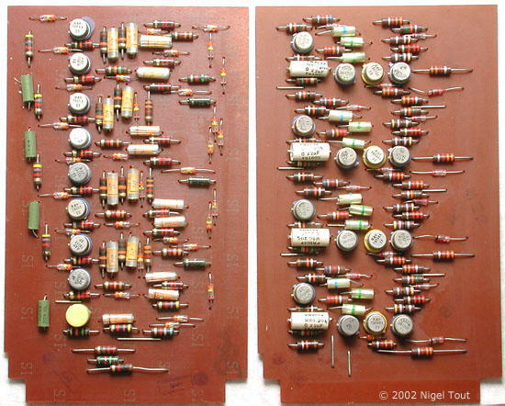
Digital Systems- A Brief History
~1960 discrete transistors (and other solid state devices) became reliable and vacuum tubes were replaced
First systems consisted of solid state devices on a substrate interconnected with discrete wires

Slide 5
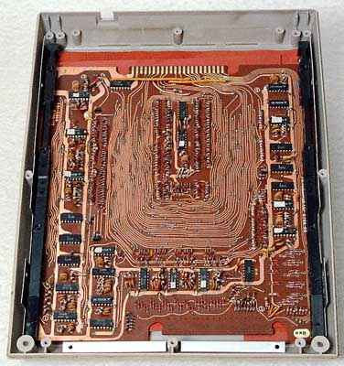
Digital Systems- A Brief History
~1965 introduction of the integrated circuit
Systems still consisted of interconnected discrete components
Not much functionality for the size
High potential for error in building
Could not be tested until built

Slide 6

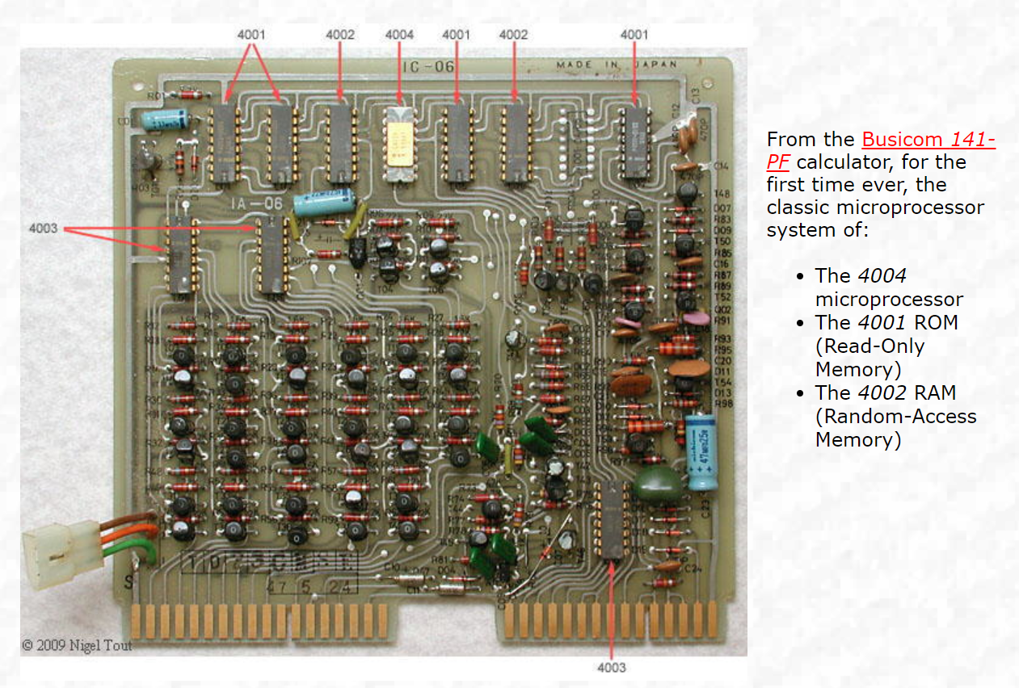
Digital Systems- A Brief History
1971 – First microprocessor
Complete system still needed ROM, RAM, timers, etc
Built from discrete components

Slide 7
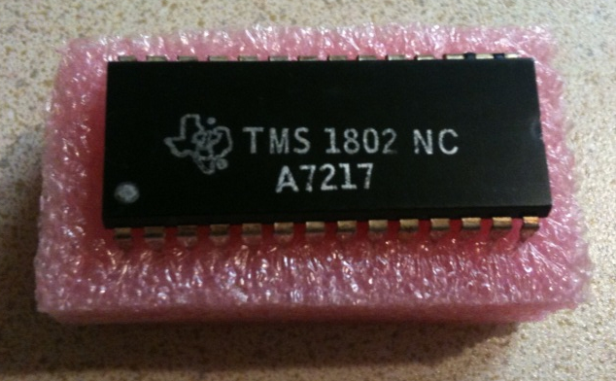
Digital Systems- A Brief History
1974 – First Microcontroller
Also known as system-on-a-chip
Has CPU, ROM, RAM, etc. all on same chip
5,000 transistors
3000 bits of program memory
128 bits of access memory

Slide 8
Digital Systems- A Brief History
1974 – 2018
Integrated Circuit technology advanced at a breathtaking pace
System on a Chip (SOC) increase in complexity
Advanced technology allows for large systems to be placed on a single full-custom integrated circuit
Negatives
High NRE (up front costs)
Long lead times
Design cannot be modified
Positives
Optimized for size
Low power
Reduced cost for high volume

Slide 9

Moore’s Law
Since the invention of the integrated circuit in 1958, the number of transistors that can be placed inexpensively on an integrated circuit has increased exponentially, doubling approximately every two years.
Think about it……
….mind blown

Slide 10
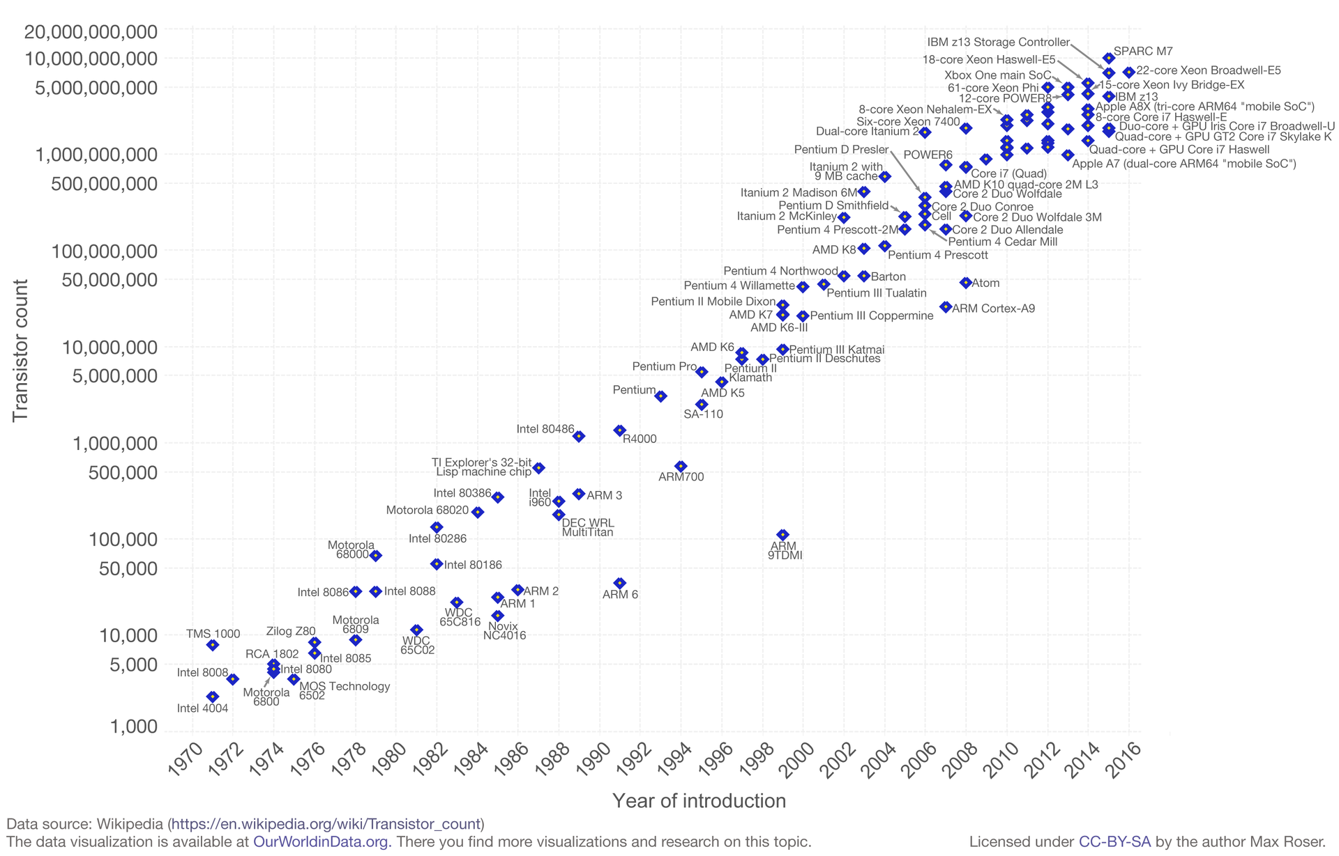
Moore’s Law

Slide 11
Where are we now?
1985 first Field Programmable Gate Array (FPGA) was developed
System on Programmable Chip (SOPC) was born
SOPC Compared to custom IC
Short lead times ( )
Lower NRE ( )
Design changes are easy (reprogram) ( )
Higher power ( )
Cost is constant despite volume ( for small volumes, for large volumes)
Have to choose from off-the shelf parts ( )
Not optimized

Slide 12
Tradeoffs
Speed,
Density,
Complexity,
Market
Volume
Needed
For
Product
Engineering Cost, Time to Develop Product
Full custom
VLSI design
ASICs
FPGAs
PLDs

Slide 13
System on Programmable Chip
Typically includes
IP (intellectual property) processor core
Custom hardware
Timers
Serial communication interfaces: UART, SPI
General purpose I/O
Digital signal processing (DSP) functions
Communications peripherals
Interfaces to off-chip devices
Memory controllers
Buses and bridges
Application-specific hardware components
Developed by the user

Slide 14
IP Cores in SOPC

Slide 15
IP Cores
What is Intellectual property (IP)
Intellectual property refers to creations of the mind
Inventions, literary and artistic works, and symbols, names, images, and designs
What are IP Cores?
Ready made function that you can instantiate into your design
Cores classified as either hard or soft
Hard Cores
Design is dedicate circuitry designed in silicon
Soft Cores
Designed using LE and general FPGA logic
Does not physically exist in silicon

Slide 16
IP Core
What are IP Cores?
Cores can range in complexity
Simple arithmetic operators
Ex: adders, accumulators, and multipliers
System-level building blocks
Ex: filters, transforms, and memories
Specialized functions
Ex: bus interfaces, controllers, and microprocessors
What are some advantages and disadvantages to using IP cores?

Slide 17
IP Cores
Benefits of using a Core
Increase design performance
Highly optimized for given architecture
Saves time designing and debugging
Cores are created by expert designers
Improves time to market
Guaranteed functionality
Spend time on your design where you add value
Less time spent on commodity design sections
Disadvantages of using an IP Core
Locks design into an FPGA architecture
Limits your migration potential to other devices
Ex: Altera ➔ Xilinx ….. Intel OR AMD?

Slide 18
Processor Cores
What is a Soft Processor?
A microprocessor fully described in software, usually in an HDL, which can be synthesized in programmable hardware, such as FPGAs
Can implement many parallel processors on one FPGA
Allow designer to define memory, ALU and peripheral functionality
Resources not used to implement processor can be used for other functionality
What is a Hard Processor
Processor implemented in silicon
Processor is actually designed into the FPGA
Hybrid approach between ASIC and FPGA
Hard Processor cores are less flexible but have higher performance
Notes:
Similar to how a VHDL circuit can be put on a FPGA to allow for high configurability, a soft processor is a processor implemented on a FPGA. This is different than a hard processor, which is a processor implemented in hardware. Soft processor is a logical schematic (software) that can be loaded onto any FPGA. So a soft processor isn’t really a processor, but just a schematic (or code like software). This gives it all the advantages of software such as giving updates and improving the development cycle.

Slide 19
Processor Cores
What is a Soft Processor?
A microprocessor fully described in software, usually in an HDL, which can be synthesized in programmable hardware, such as FPGAs
Highly configurable and customizable to the application
Can implement many parallel processors on one FPGA
Allow designer to define memory, ALU and peripheral functionality
Implemented in the FPGA’s “sea of gates”
Resources not used to implement processor can be used for other functionality
Slower clock rates and more power consumption
Examples: Altera NIOS II, Xilinx Microblaze
Notes:
Similar to how a VHDL circuit can be put on a FPGA to allow for high configurability, a soft processor is a processor implemented on a FPGA. This is different than a hard processor, which is a processor implemented in hardware. Soft processor is a logical schematic (software) that can be loaded onto any FPGA. So a soft processor isn’t really a processor, but just a schematic (or code like software). This gives it all the advantages of software such as giving updates and improving the development cycle.

Slide 20
Processor Cores
What is a Hard Processor?
The processor is embedded in the silicon of the FPGA
Does not use the FPGA’s normal logic elements (sea of gates)
If the hard processor is not implemented in the particular system, its gates are not available for any other use
Not very configurable
Higher performance
Can run at higher clock speeds than Soft-core processor because it is optimize
Examples: Altera ARM, XILINX PowerPC

Slide 21
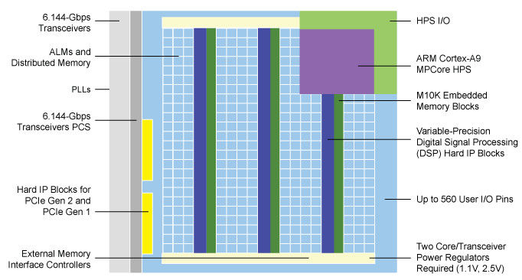
Processor Cores
Dedicated hard
core processor
Altera Cyclone V FPGA
Soft core processor
Built from general
logic

Slide 22
Processor Cores
Soft Processor vs. Hard Processor
 | Soft Processor | Hard Processor
Configurability | High | Low
Predictability | Low | High
Software Tools | Fewer | More
Speed | Low | High

Slide 23
Processor Cores
Why use a Soft Processor? (because we will!)
Higher level of design reuse
Reduced obsolescence risk
Design can be modified to accommodate changing requirements
Easy to add new features and functionality to design
Increased design implementation options
Add only processor features that are required by design
Able to start design w/o all requirements finalized
Lower latency between processor and FPGA components
No routing delays to route external processor signal into FPGA
Can use FPGA logic for accelerating software functions
Software functions migrated to hardware
Create custom instructions to access custom hardware

Slide 24
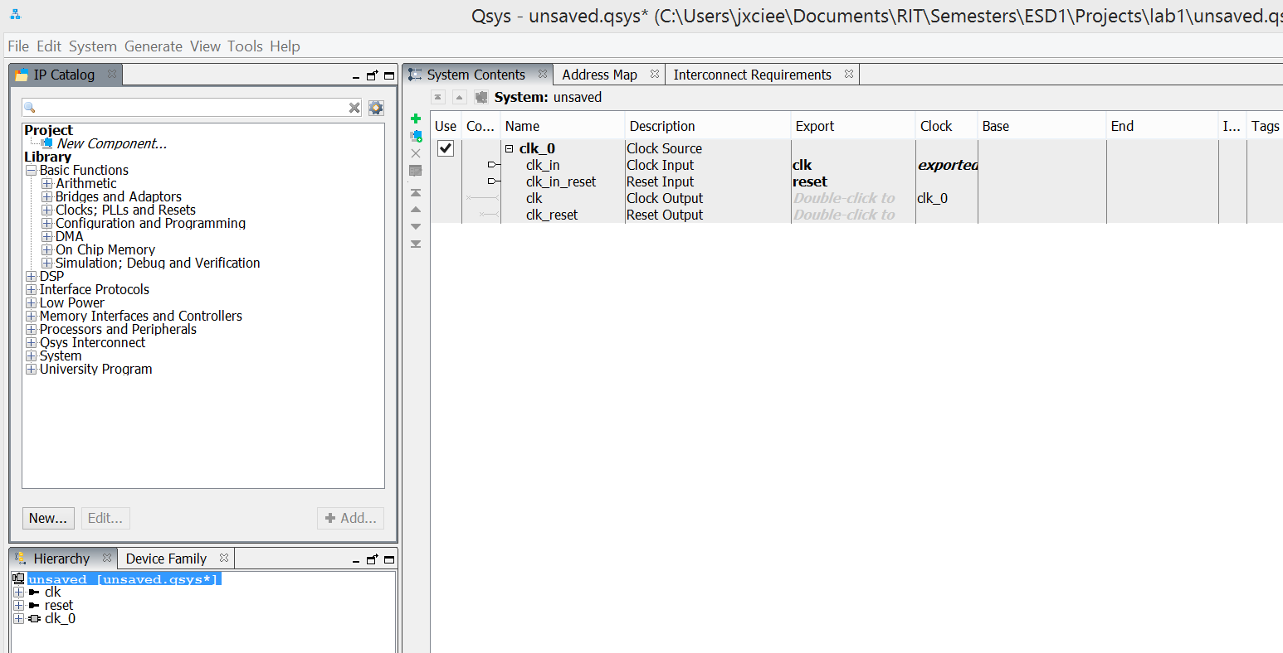
Using IP Cores
Altera Platform Designer System Builder
Library of Cores from which to choose

Slide 25
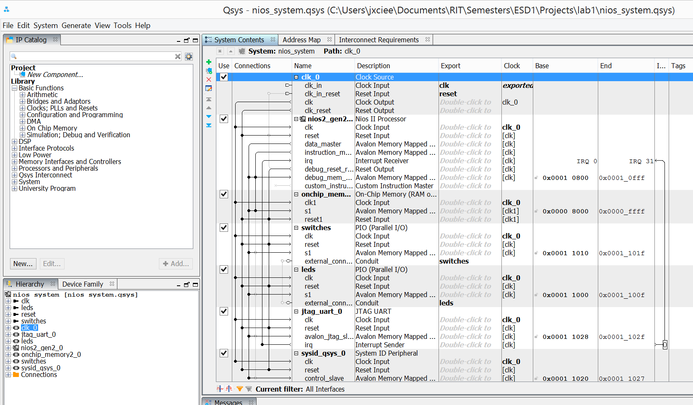
Using IP Cores
Processor
Memory
I/O

Slide 26
Using IP Cores
Build system in Platform Designer
Use library of cores
Interconnect cores with each other, clocks, resets, interrupts, etc.
The tool generates the hardware description language for the system (includes processor design, if using soft core)
The designer instantiates the generated system as a component in the top-level HDL
In the top-level HDL the system component can be integrated with other components developed by the designer

